Slide 1
GCAM Training 1 Overview

Slide 2
Contents
Introduction
GCAM
Overview
Systems
Data flows
Modeling Framework
Example Projects
Conclusions

Slide 3
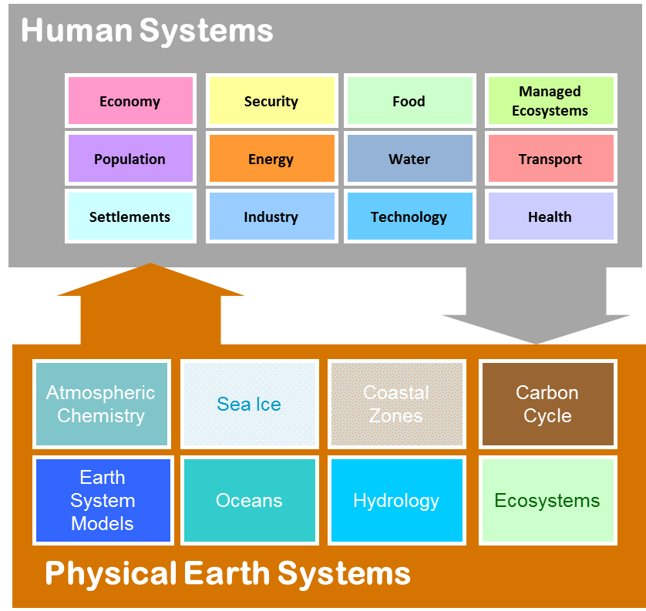




Introduction – Integrated Assessment Models (IAMs)
Provide nexus insights otherwise unavailable from disciplinary research alone.
Capture complex non-linear system Interactions
Support national, international, regional, and private-sector decisions.
Examples: AIM, GCAM, IGSM, IMAGE, MESSAGE, REMIND

Slide 4
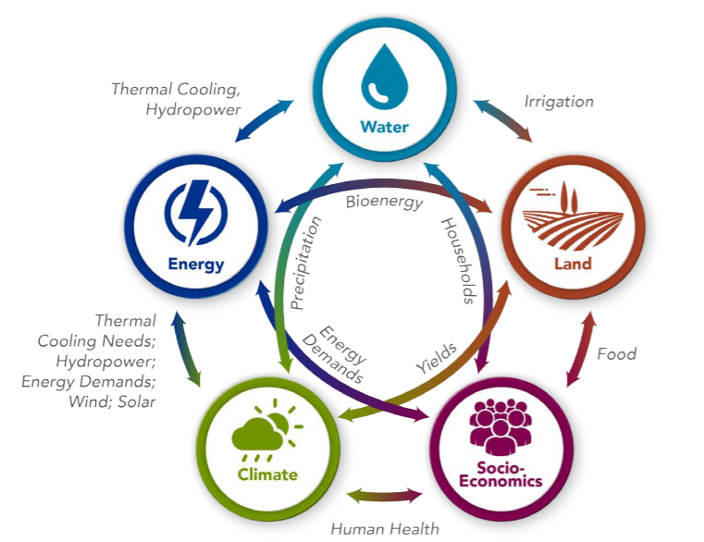
Overview of GCAM

Slide 5
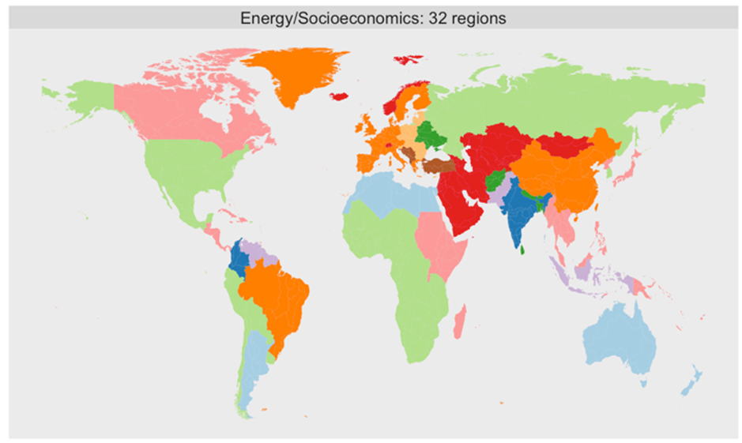
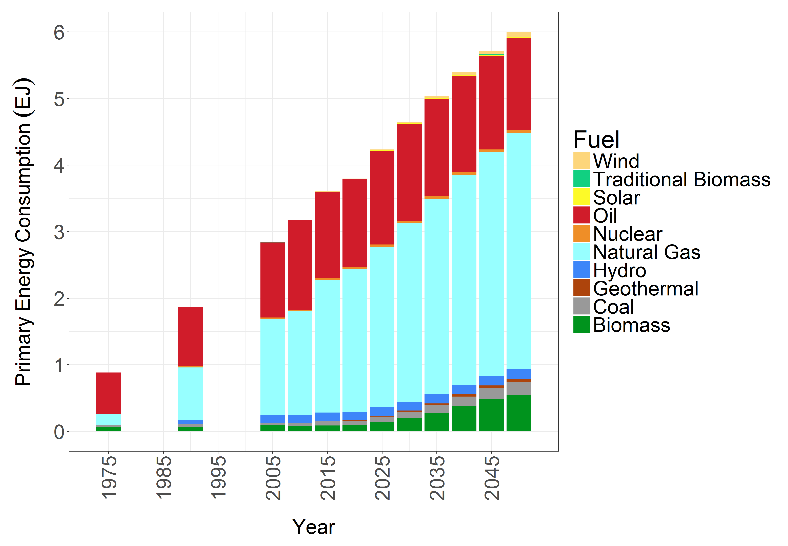
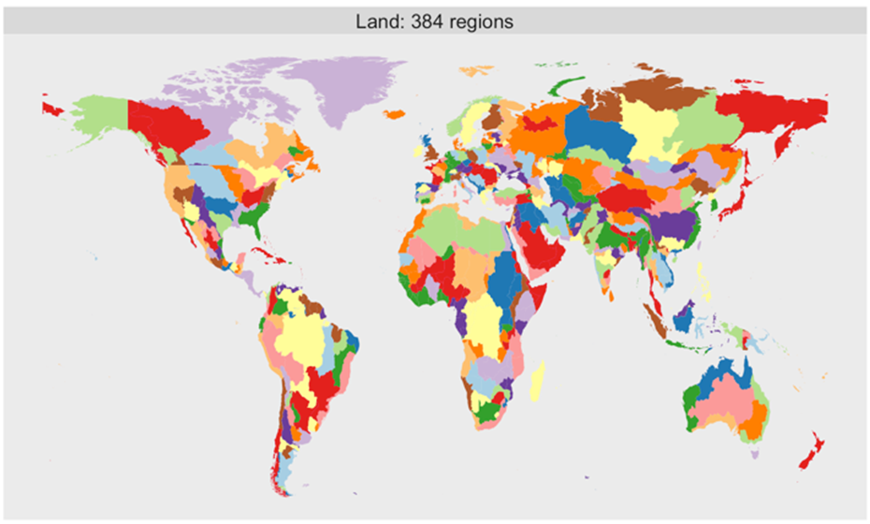
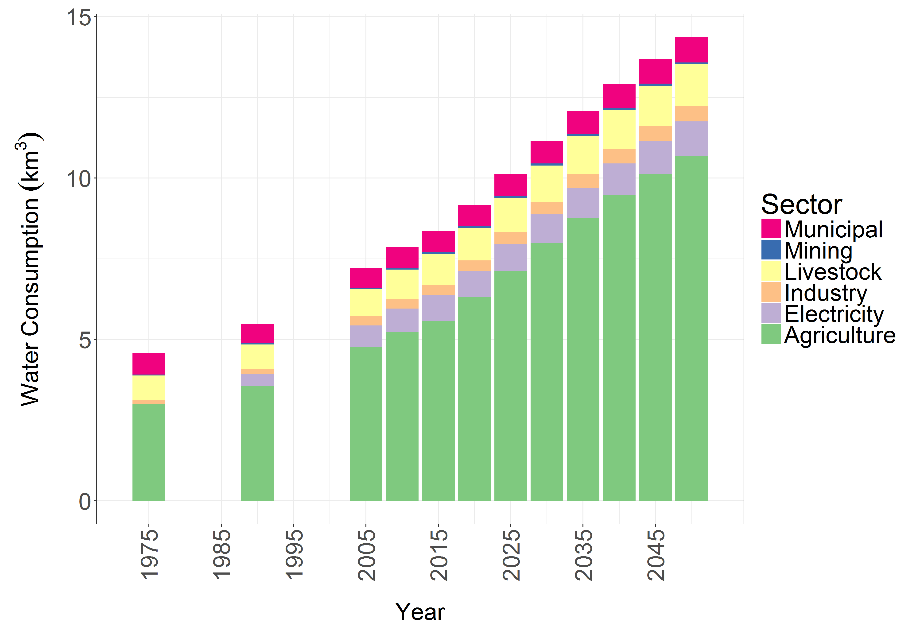
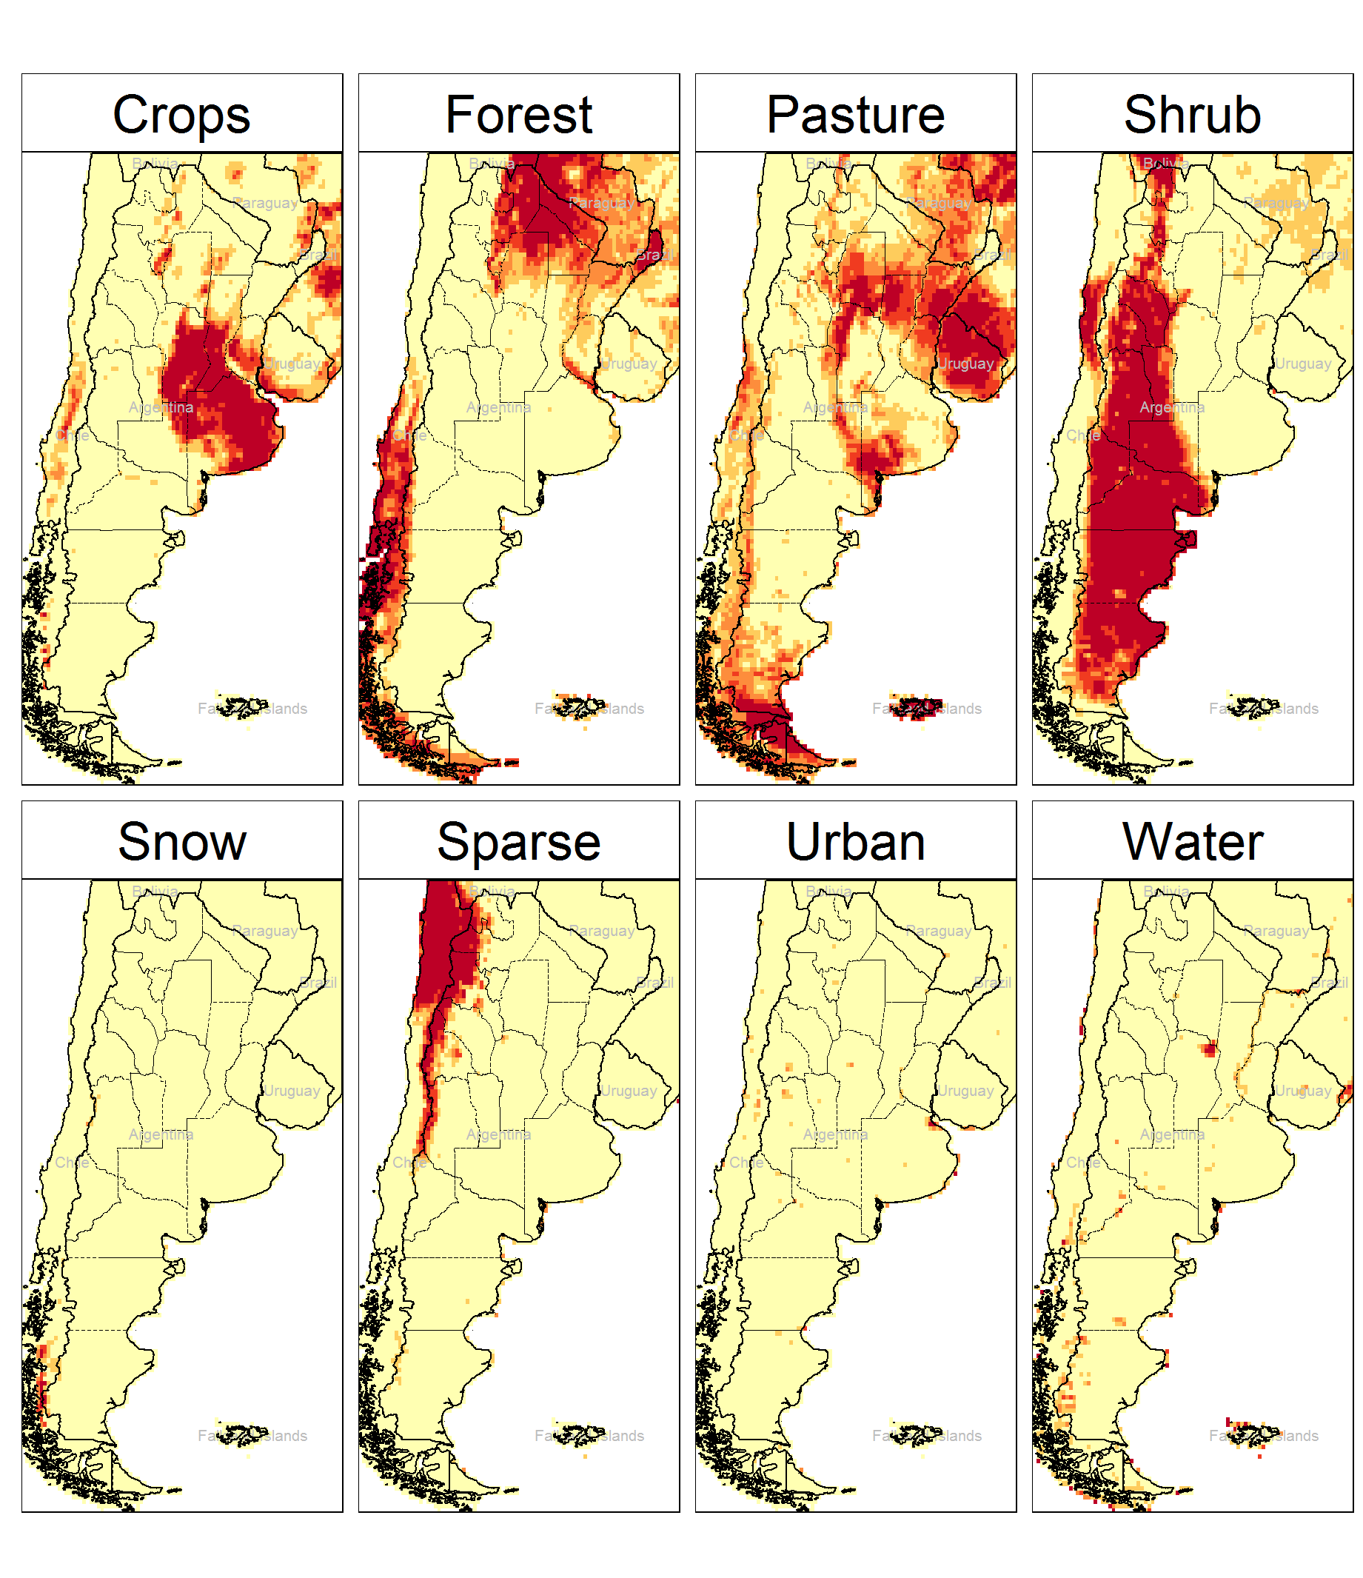
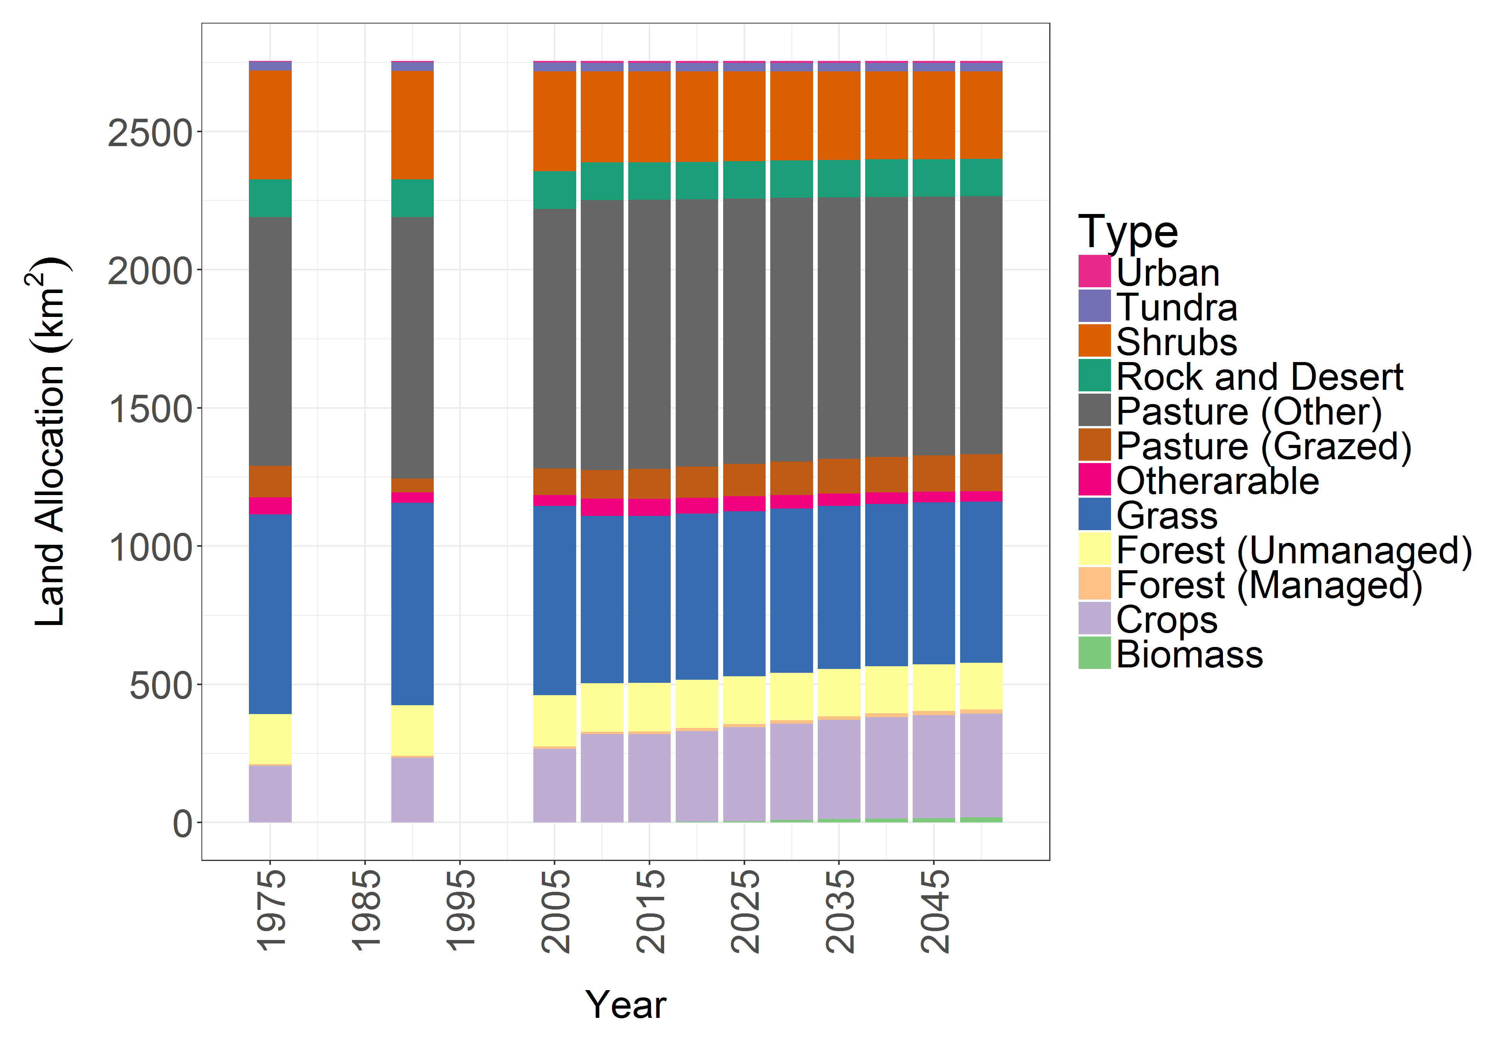
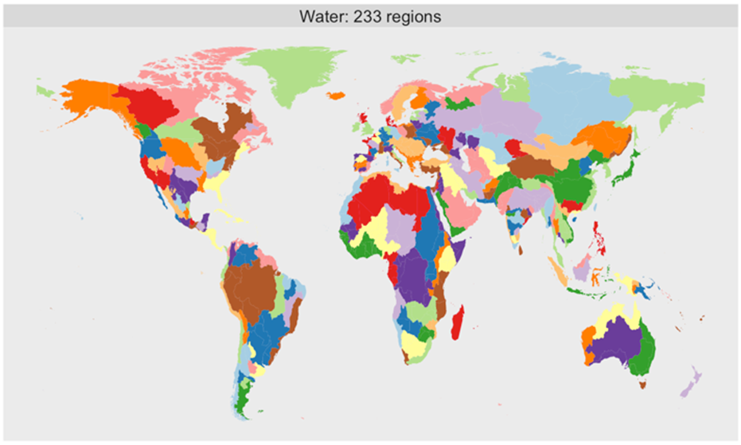




GCAM
GCAM is a global long-term integrated assessment model
GCAM links Economic, Energy, Land-use, Water, and Climate systems
Regional – 5 year
Energy
Downscaling Tools
32 Energy Economy Regions
Gridded – Monthly
Water
384 Land Regions
Land-Use
235 Water Basins

Slide 6
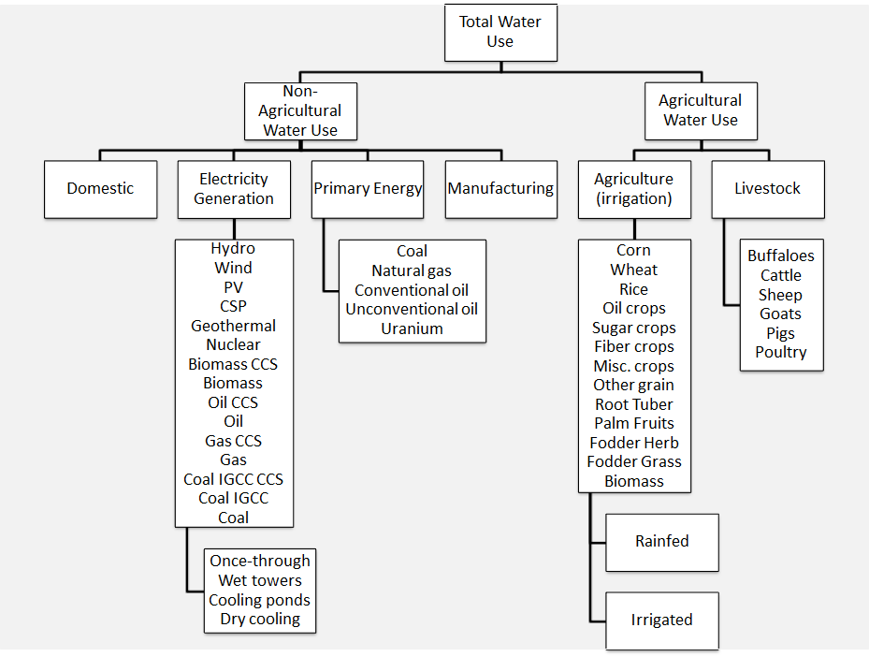
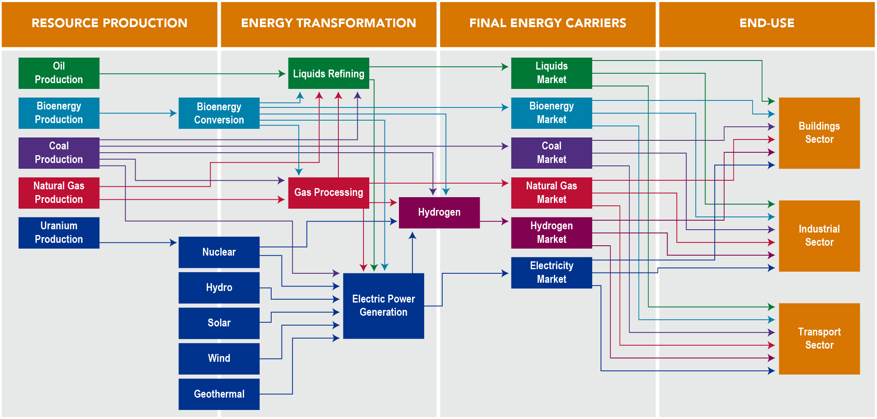
GCAM - Systems
Water
The Energy System
Land
GCAM Documentation: http://jgcri.github.io/gcam-doc/toc.html

Slide 7
GCAM – Systems (Energy Detail)
Resource Production
Energy Transformation
Final Energy Carriers
End-Use
Oil Production
Liquids Refining
Liquids Market
Bioenergy Production
Bioenergy Conversion
Bioenergy Market
Buildings Sector
Coal Production
Coal Market
Natural Gas Market
Industrial Sector
N. Gas Production
Gas Processing
Uranium
Nuclear
Hydrogen
Hydrogen Market
Transport Sector
Hydro
Electric Power Generation
Electricity Market
Solar
Wind
Geothermal

Slide 8
GCAM – Systems (Energy Detail)
Liquids Market
Bioenergy Market
Buildings Sector
Buildings Technologies
Coal Market
GCAM has service- and technology-level representations for the transportation & building sectors in all regions
Natural Gas Market
Industrial Sector
Industrial Technologies
Hydrogen Market
Transport Sector
Transport Technologies
Electricity Market

Slide 9
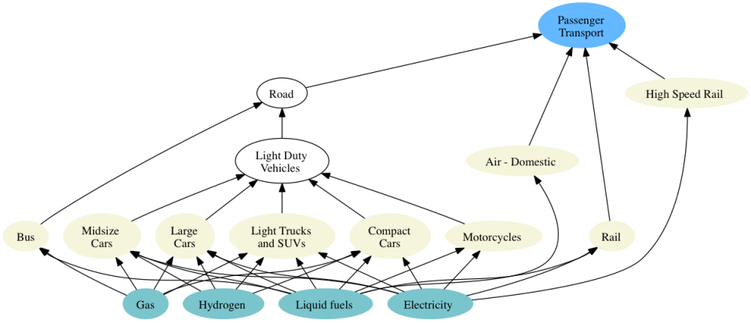
GCAM – Systems (Energy Detail)
Both passenger (passenger-km) and freight (tonne-km) services are represented in each region with multiple sectors and technologies for each
The choice among modes of transportation is a function of the cost of travel, the time it takes, and income.

Slide 10
GCAM – Systems (Energy Detail)
Per-capita Residential and Commercial Energy Use in 2010
Residential and Commercial building are represented in terms of m² of floorspace.
Heating, Cooling, and Other energy services to buildings are then supplied each building type.

Slide 11
GCAM – Data Flow
Modeled Scenario
Population
Labor Productivity
Scenario Assumptions
Technology Characteristics
Model Equations, Relationships, and Parameters
Population
Policies
Labor Productivity
Emissions
Technology Characteristics
Prices
Energy Supplies and Demands
Policies
Agricultural Production
Land Use
Concentrations and Temperature

Slide 12
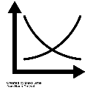
GCAM – Modeling Framework
Market Equilibrium Solution

Slide 13
Logit Choice Mechanism for Decision Making
Calibrated logit approach assumes a distribution of realized costs due to heterogeneous conditions.
Market share based on probability that a technology has the least cost for an application.
Avoids a “winner take all” result.
Historical calibration influences future competition through the “share-weight” (α)
13

Slide 14
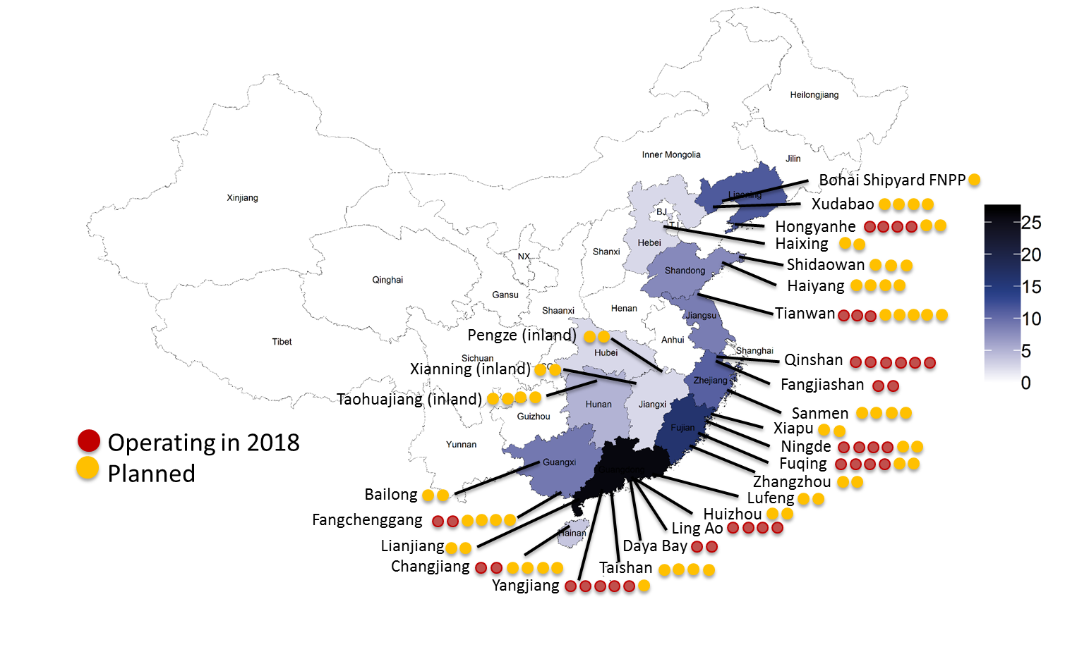
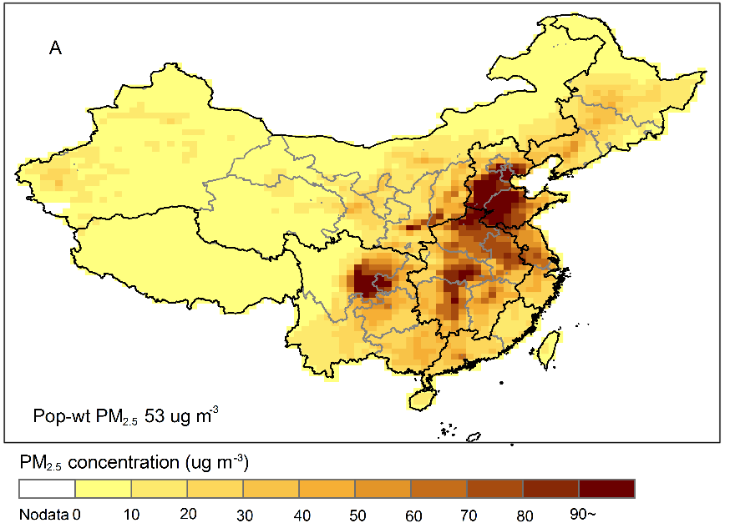
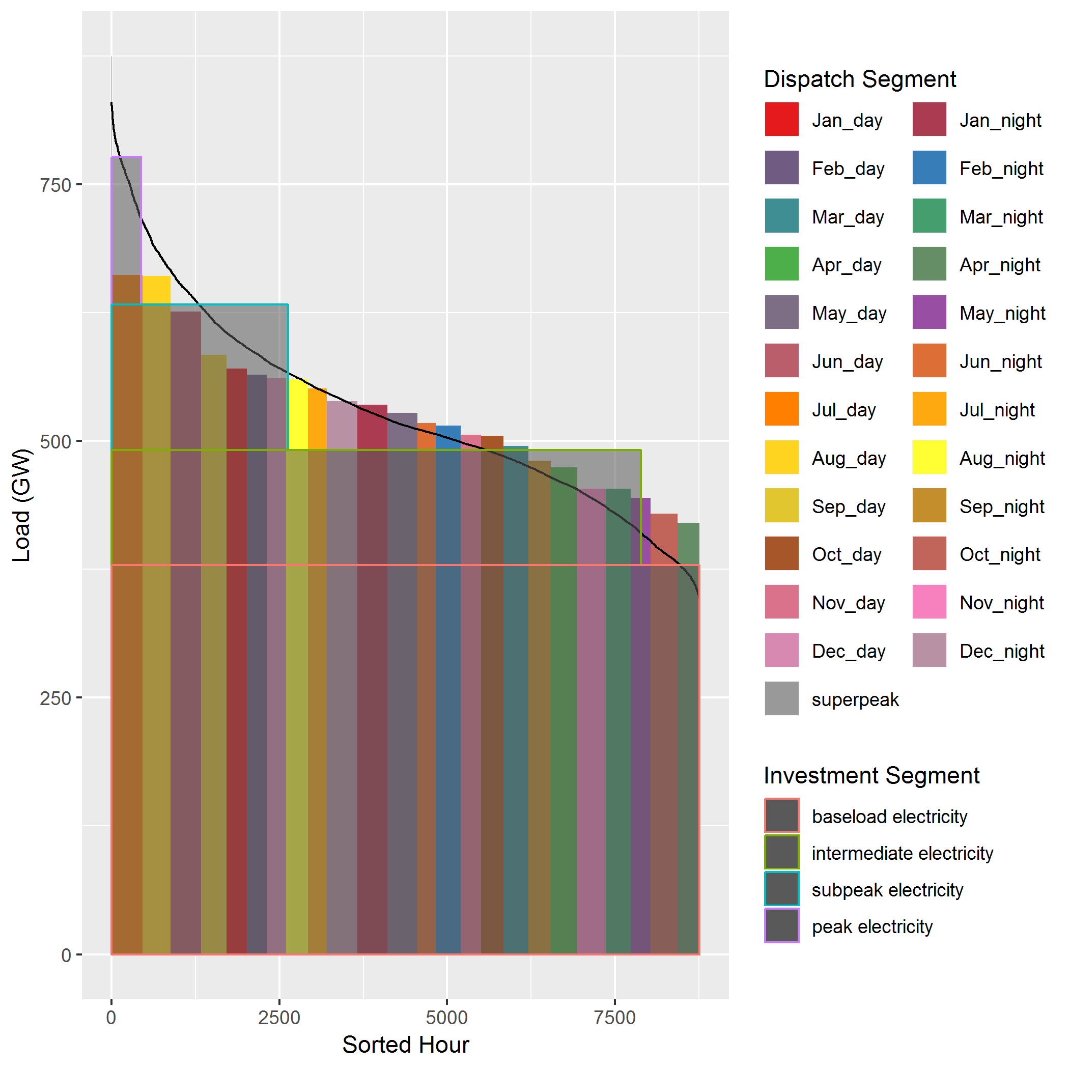
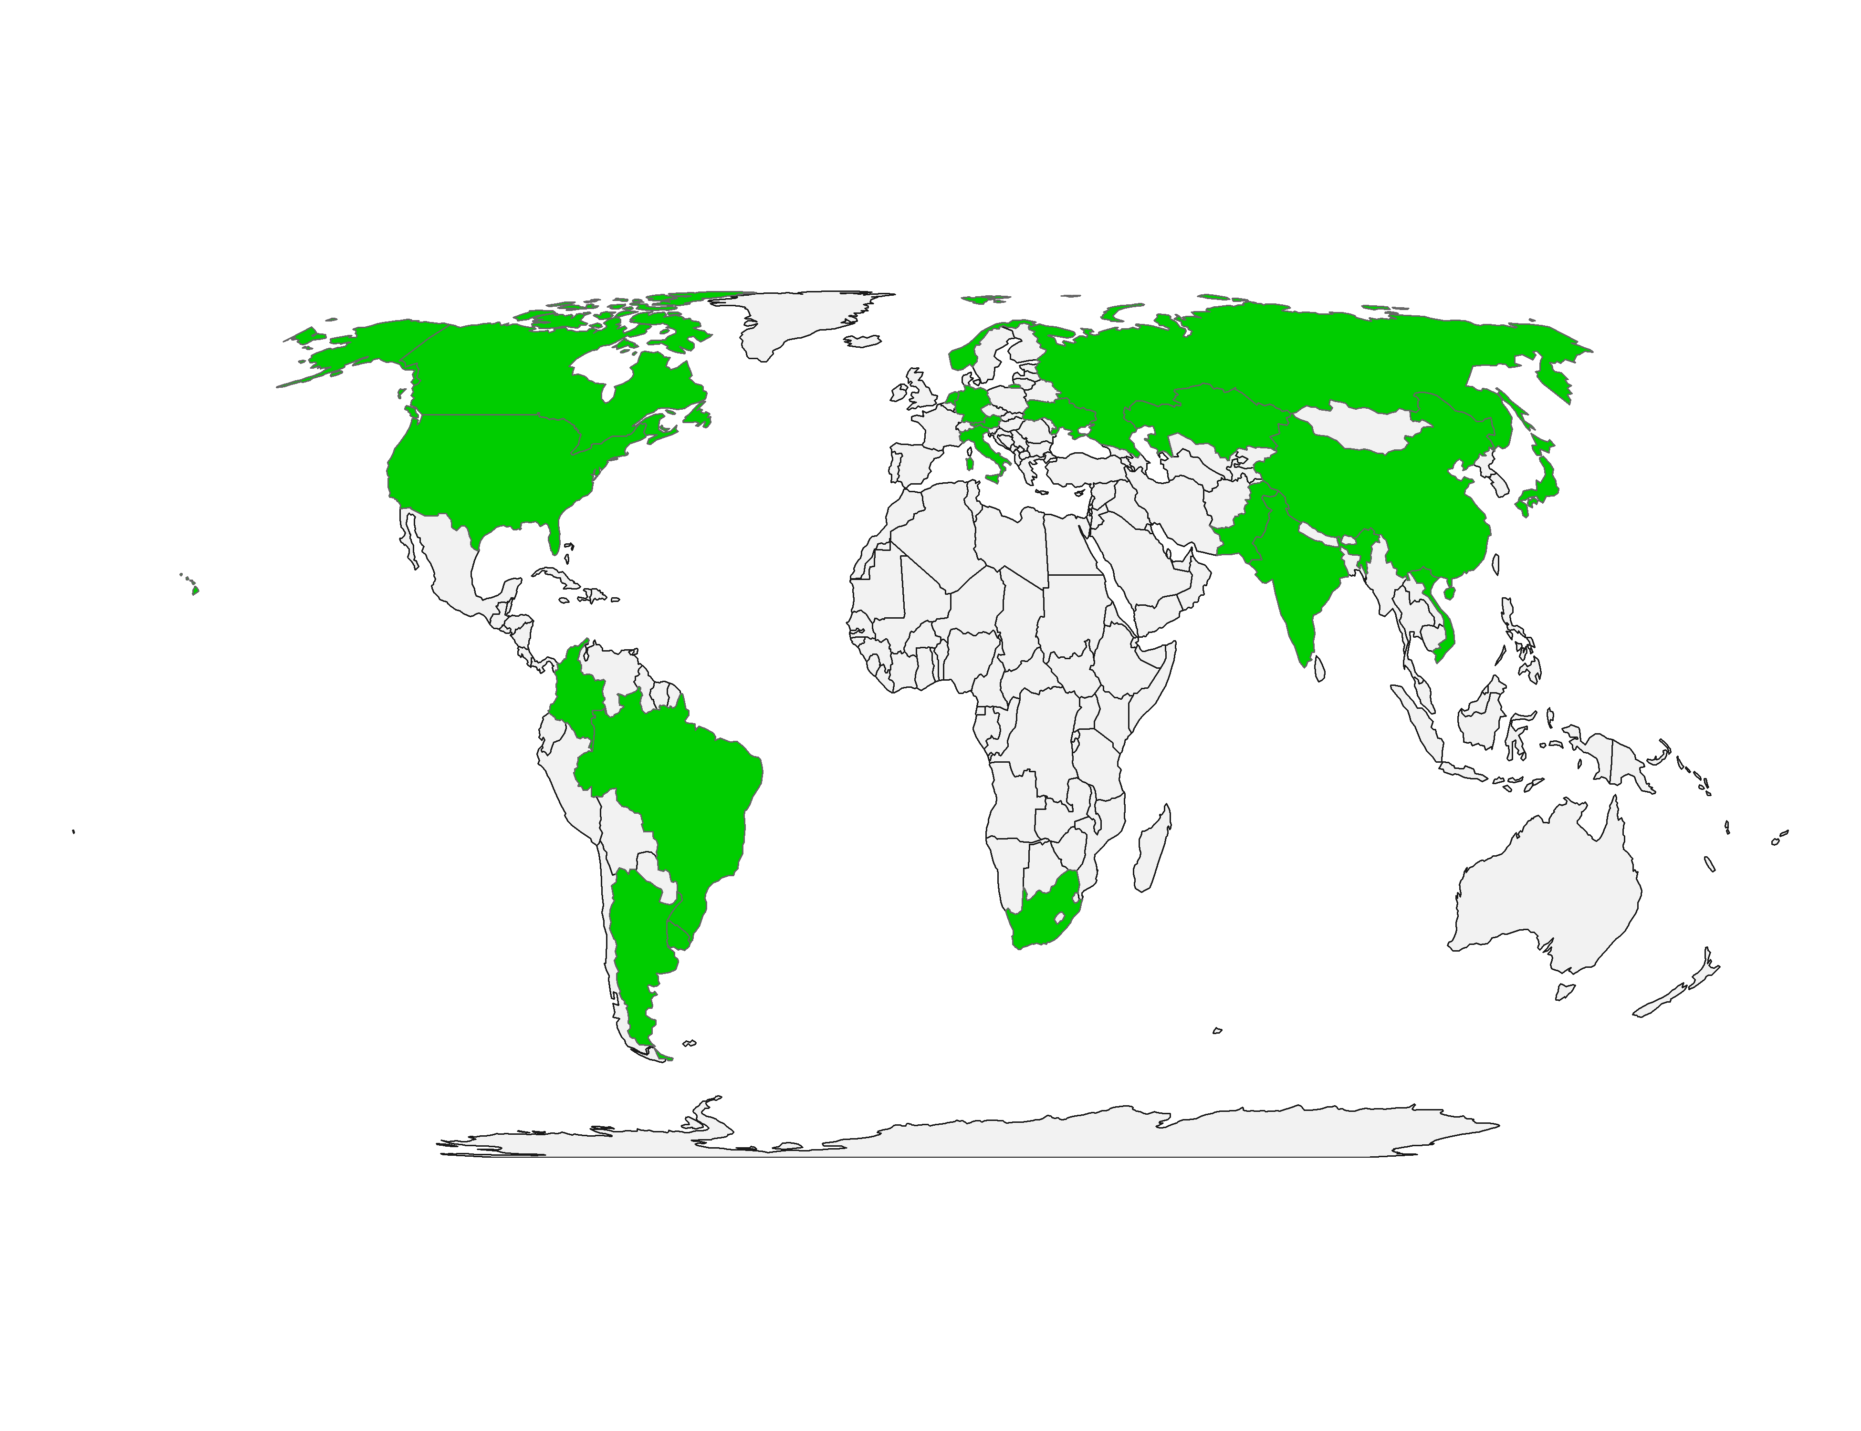
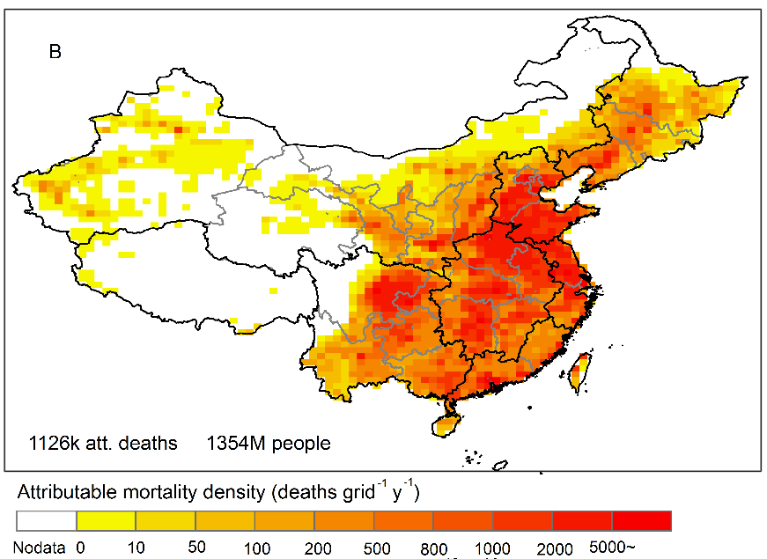
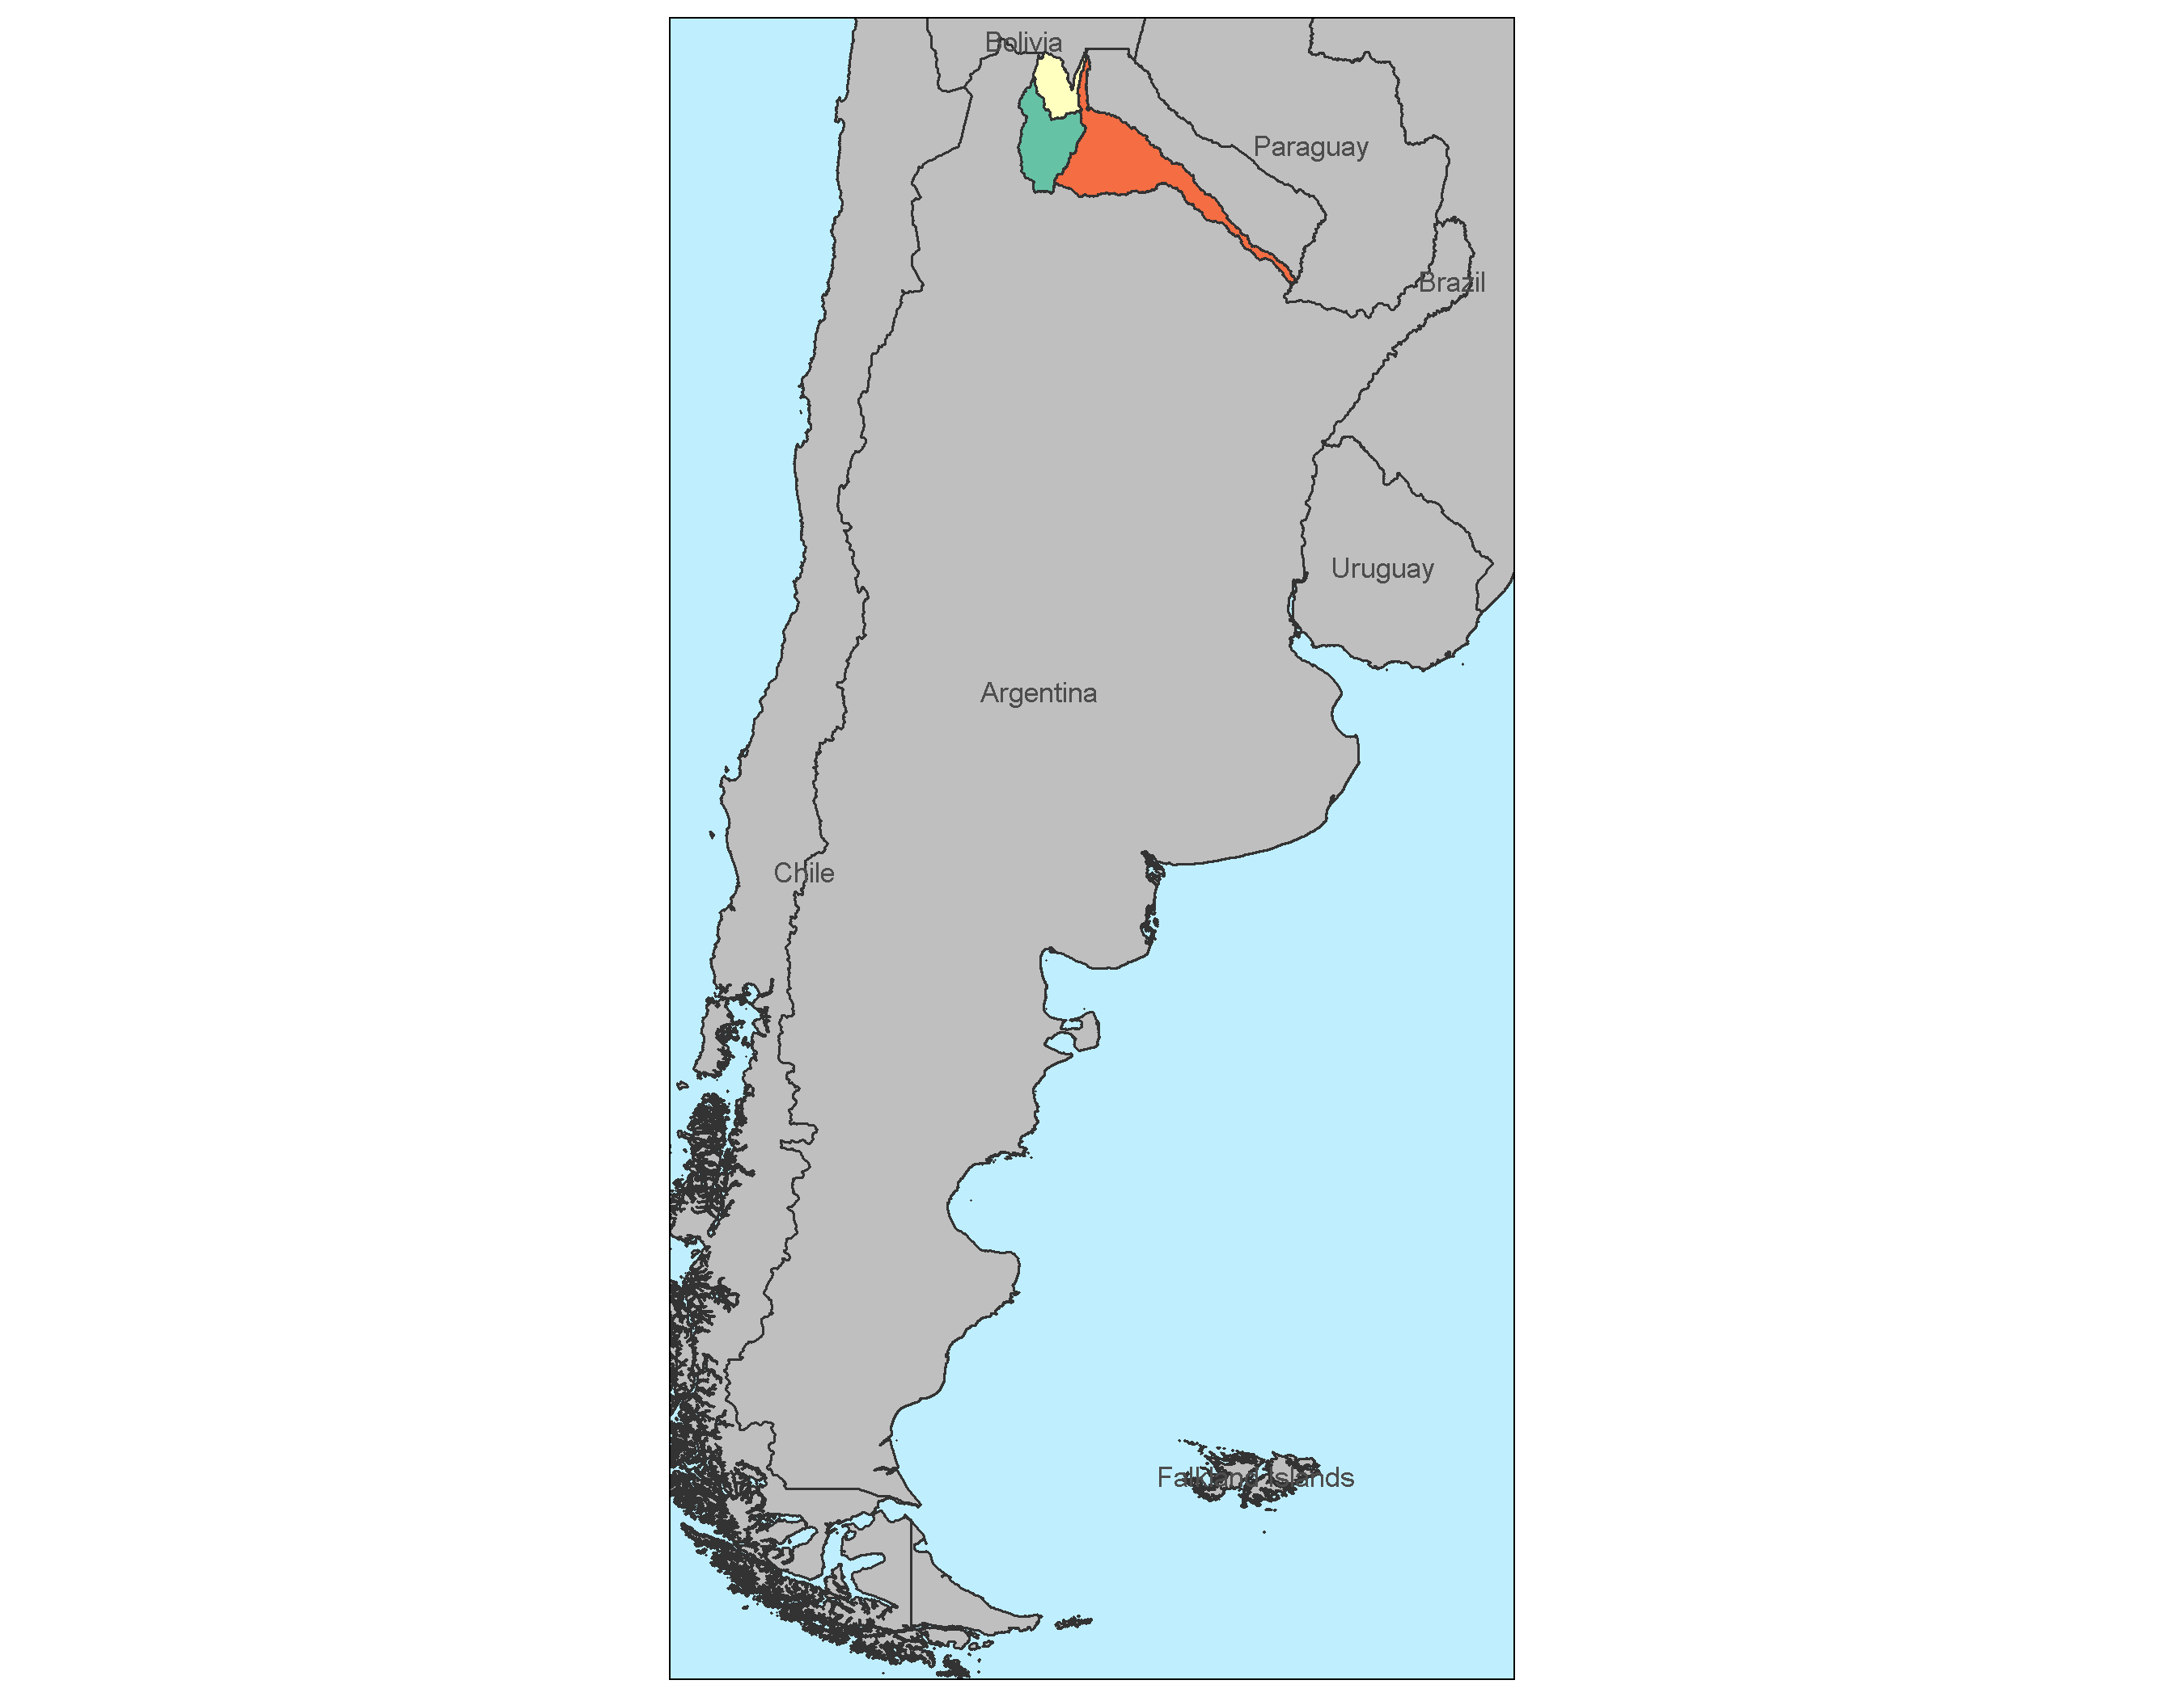
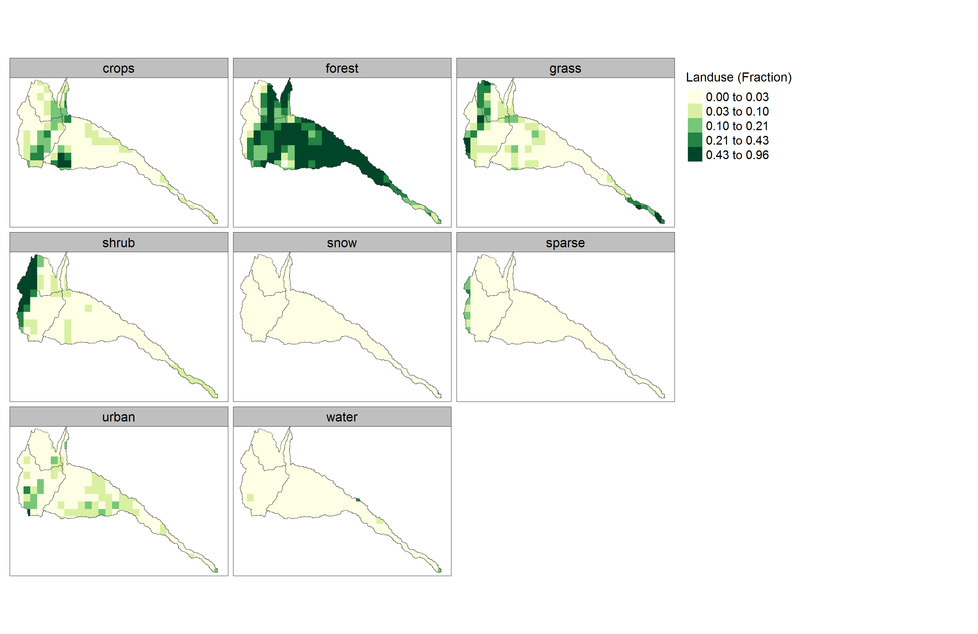
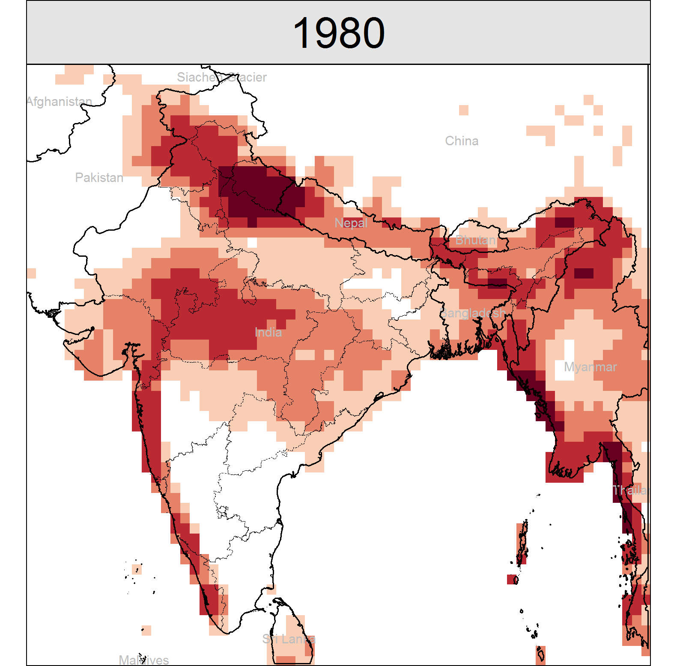
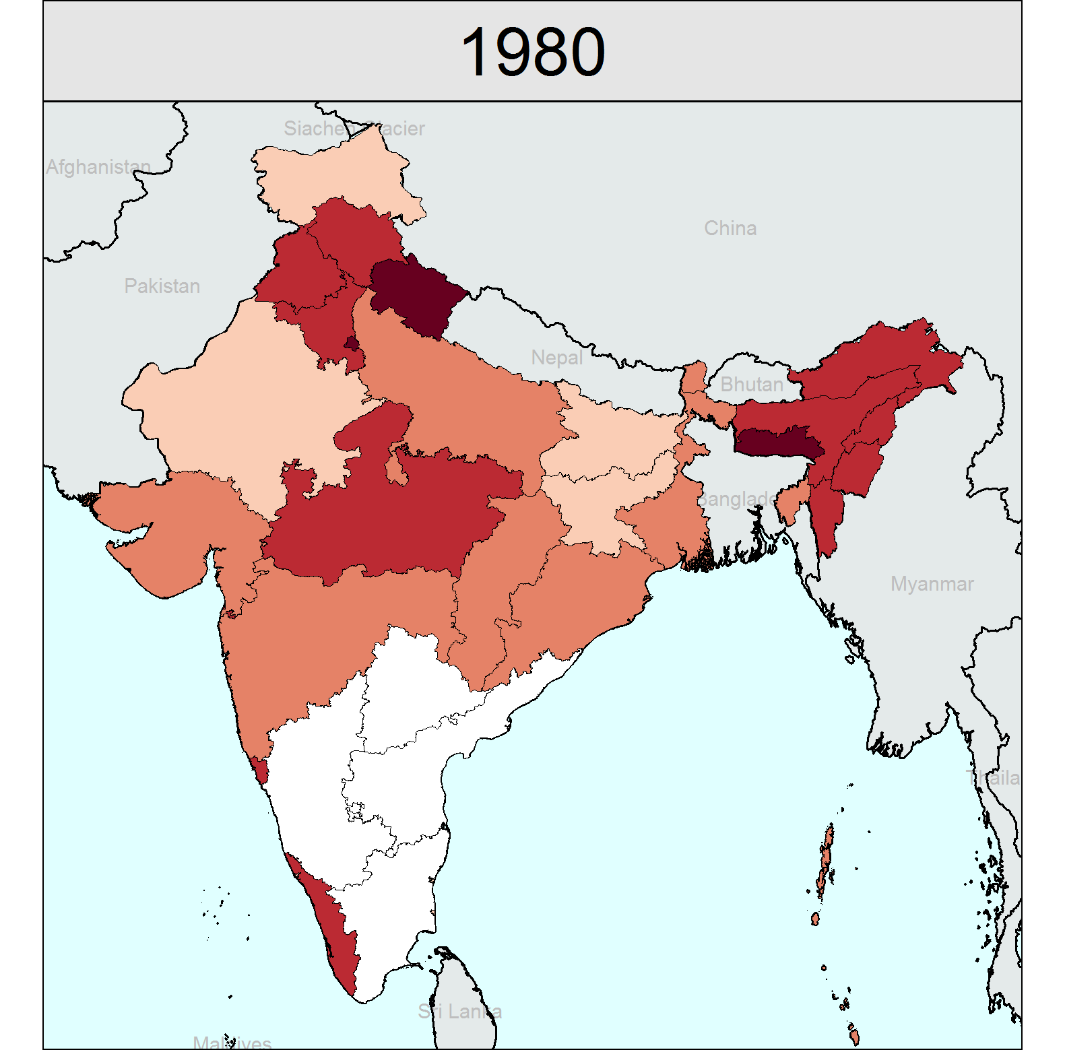
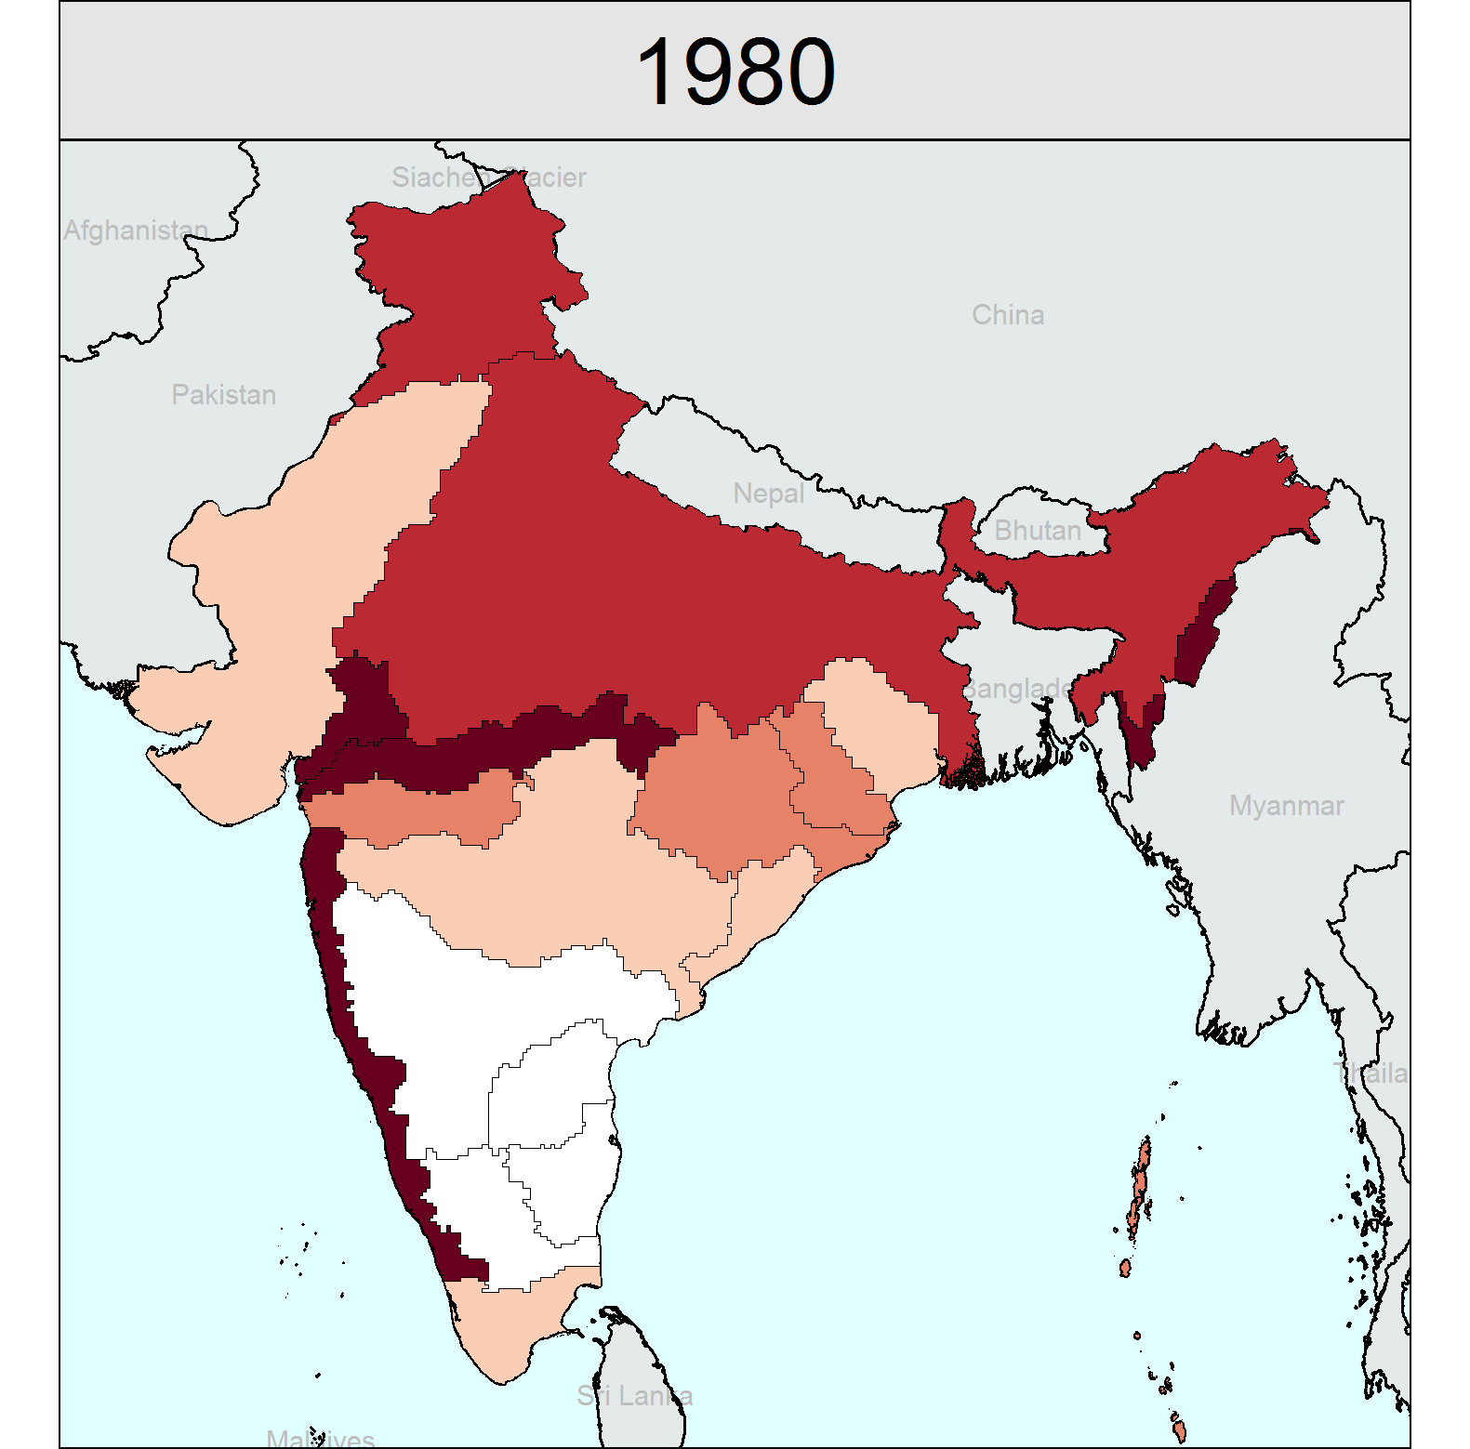
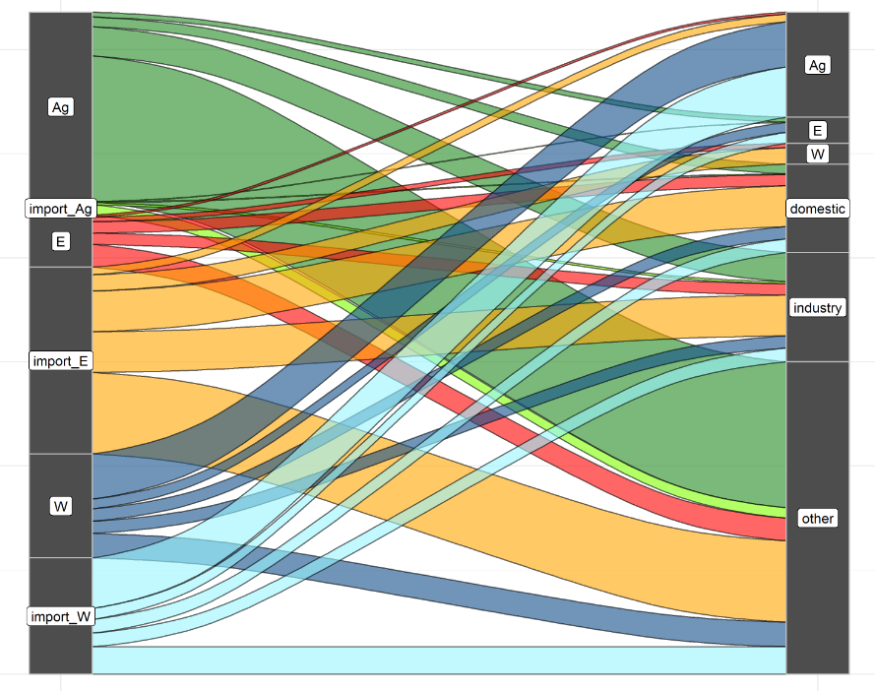
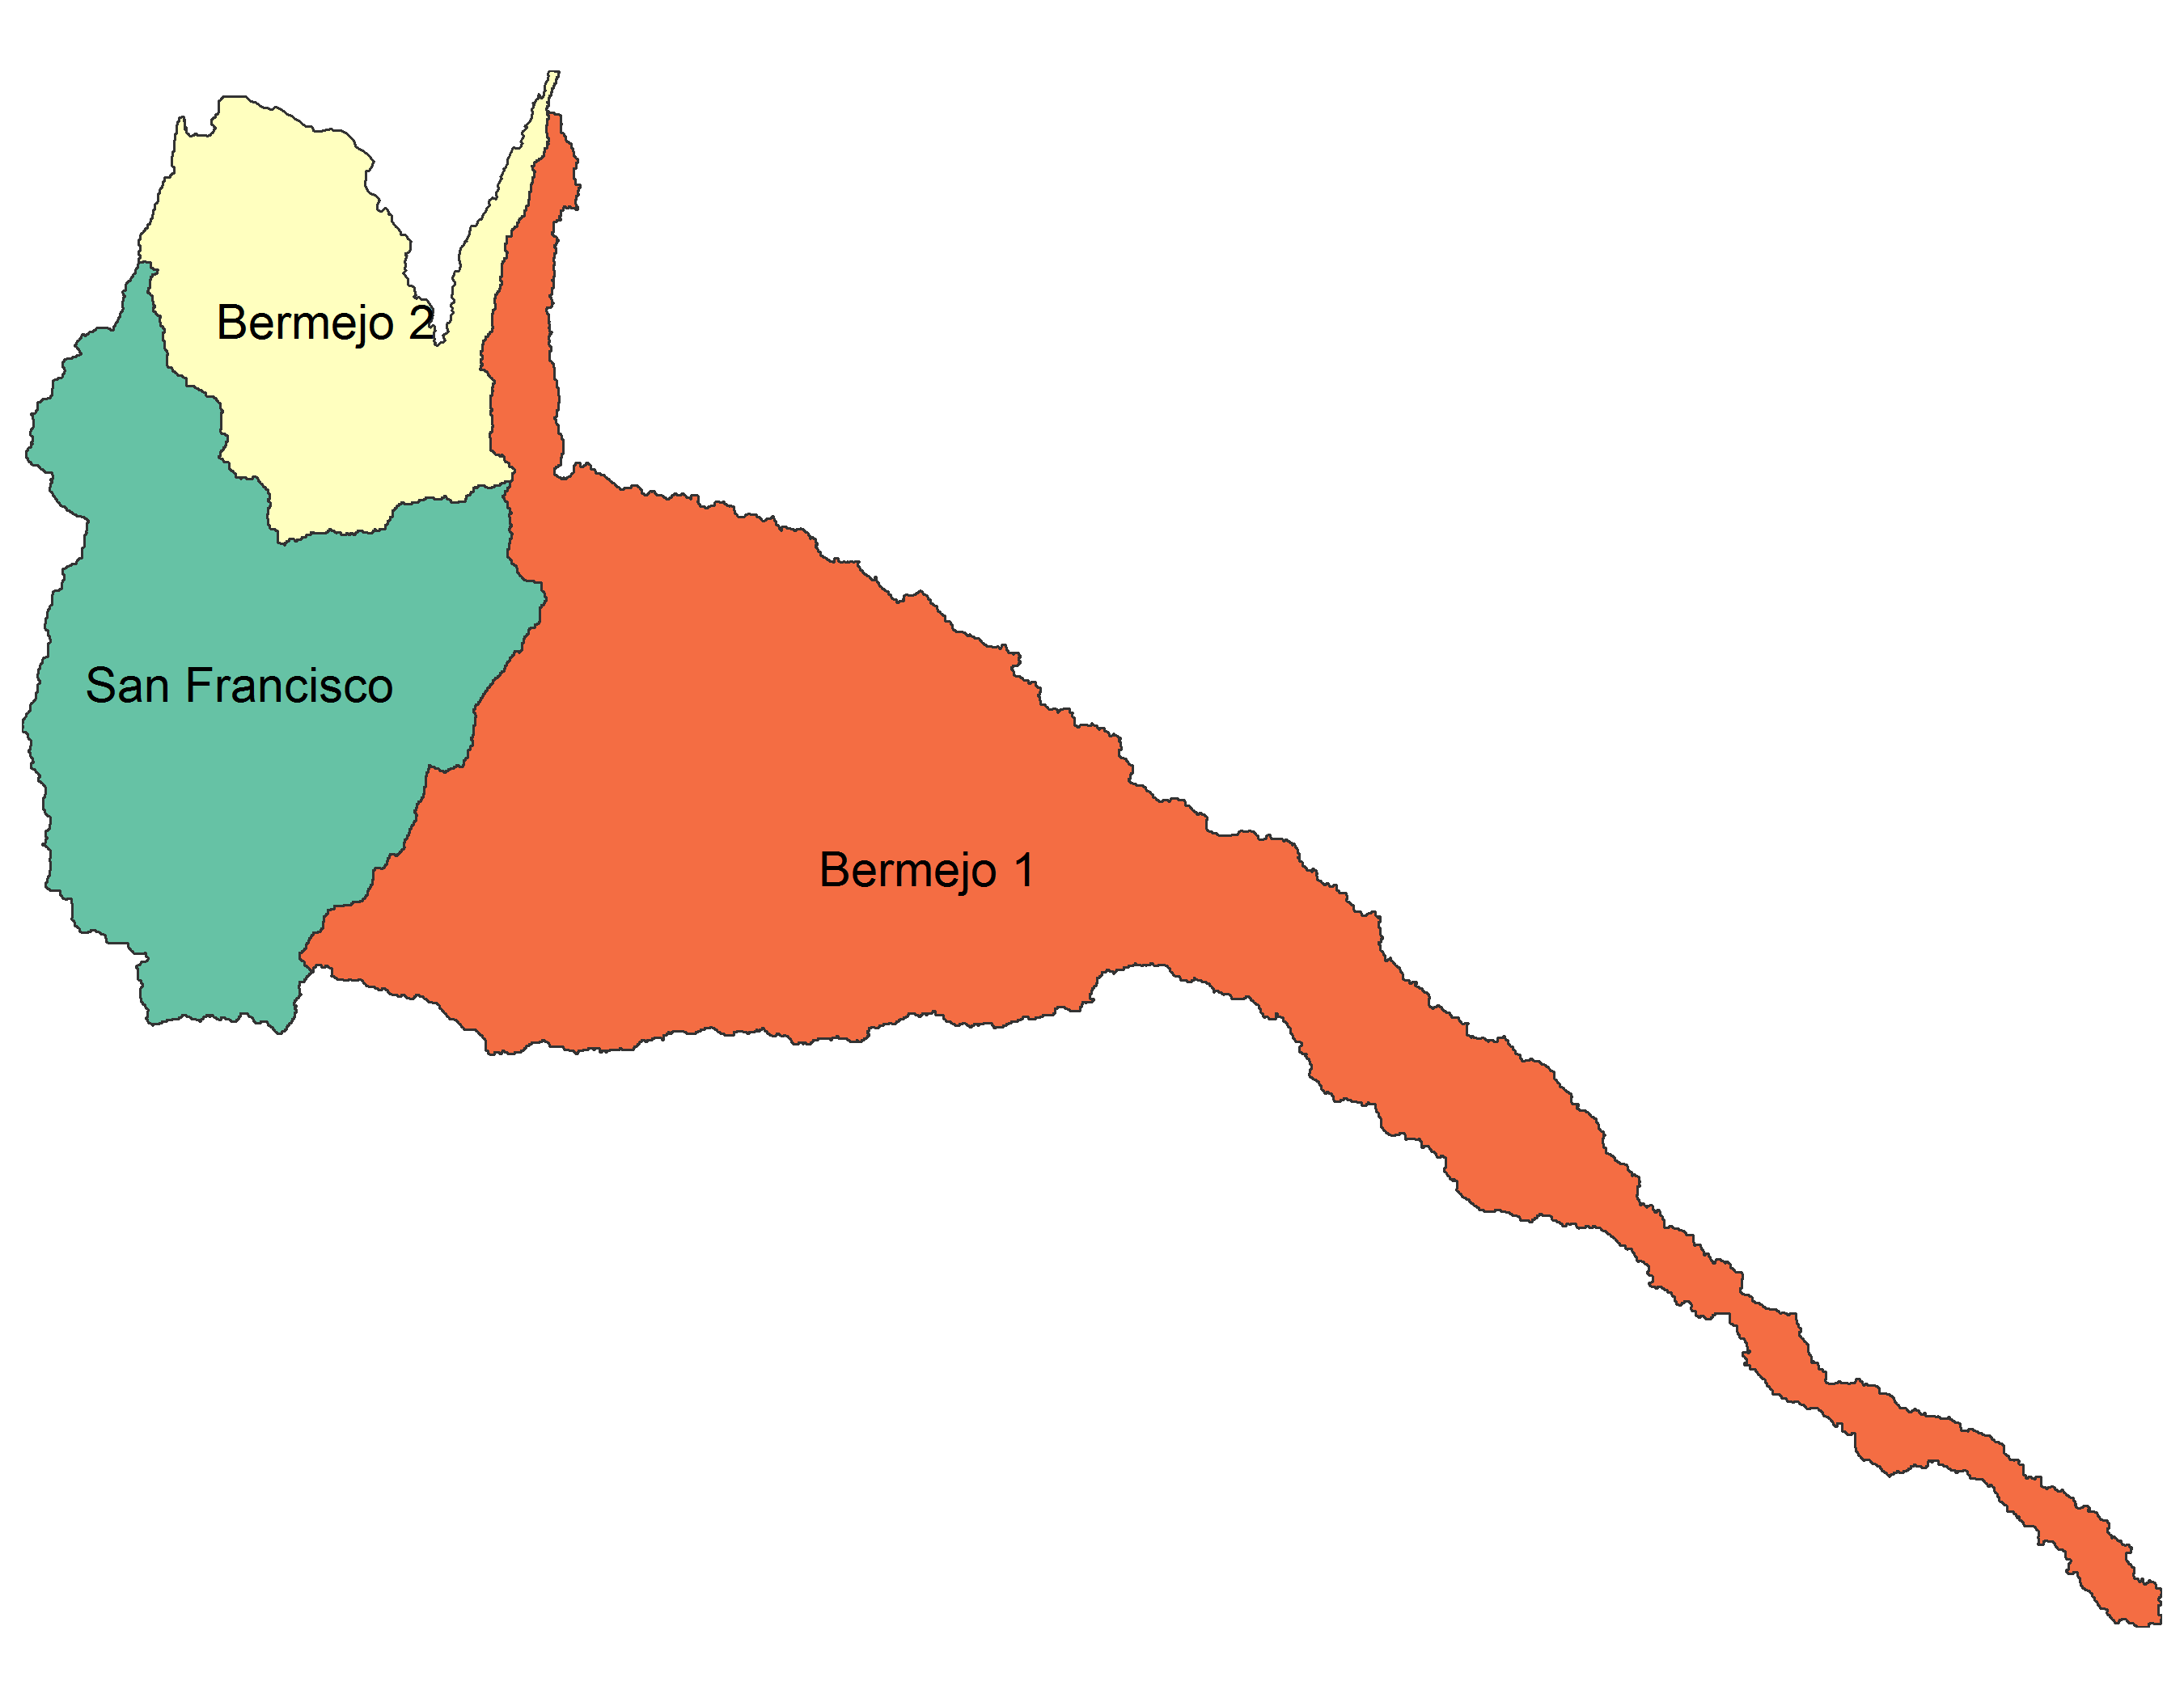
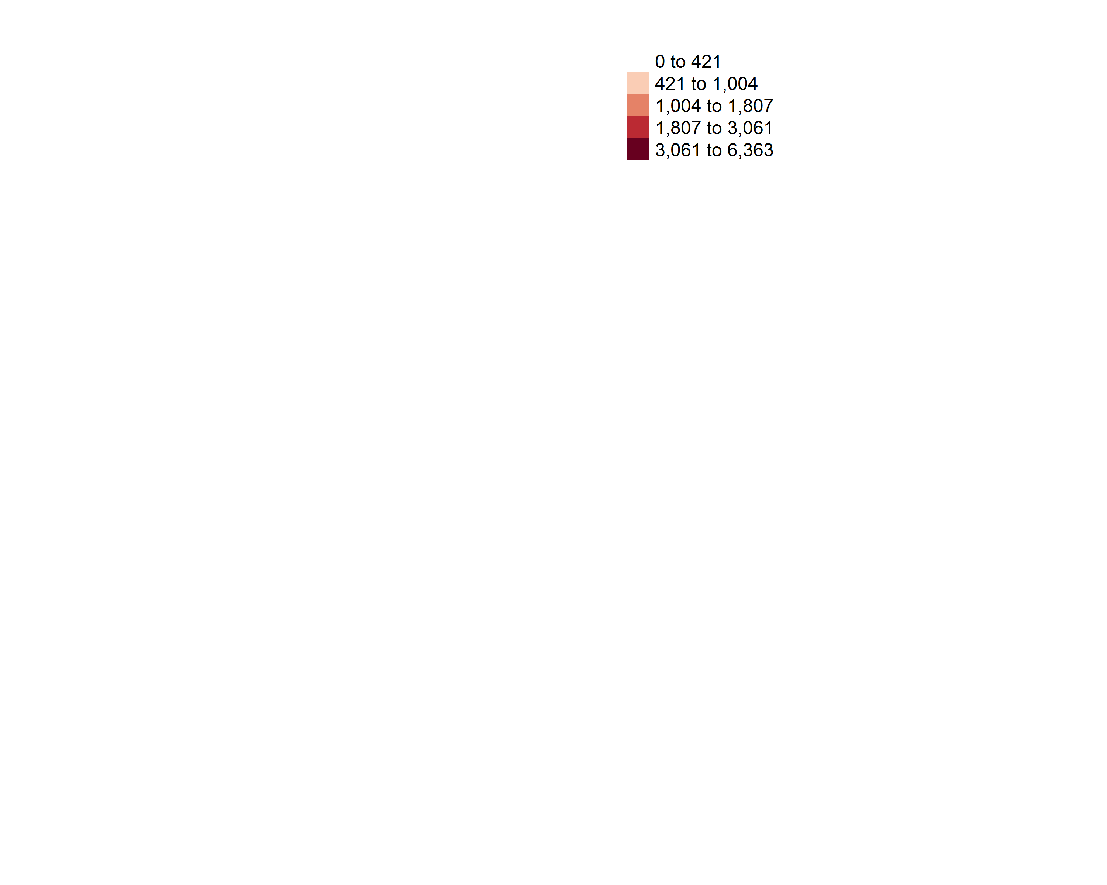
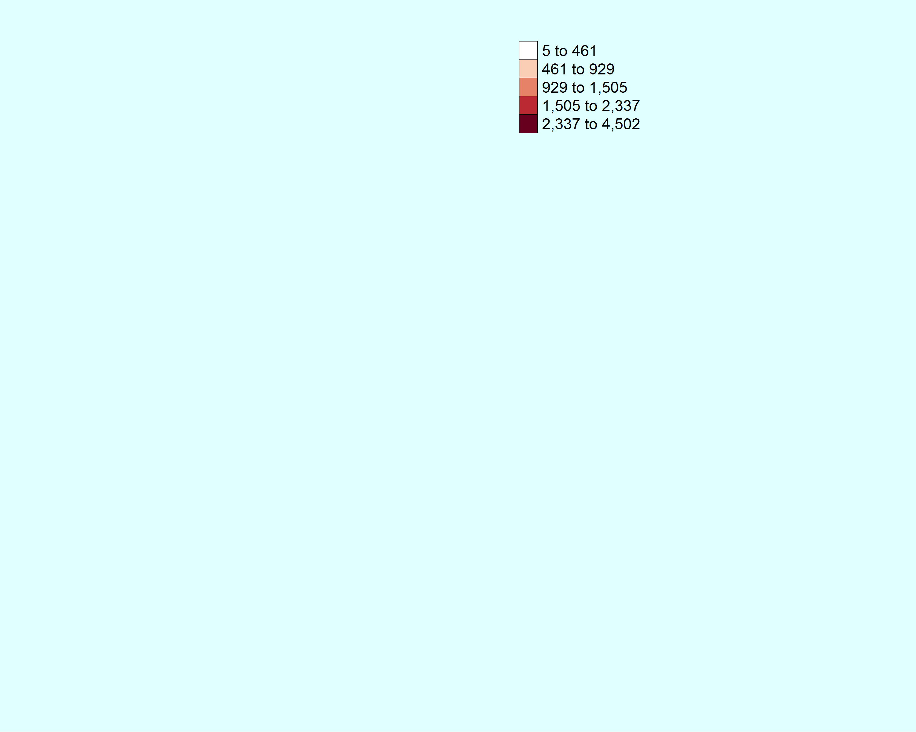

Example Projects
China – Provincial – Emissions/Health
Nuclear
Emissions
US – States – Sub-annual
Electricity Dispatch Profiles
Air Quality
Health
IDB – Sub basin – Nexus
India – States/Basins – Water Scarcity
Gridded
States
Basins

Slide 15
Projects and Collaborations
Moscow City, Murmansk Region, Chelyabinsk Region
Institute of Global Climate and Ecology, The Center for Energy Efficiency (CENEf), WWF Russia
Scientific Research Institute of Automobiles and Transportation (NIIAT), Scientific Research Institute for Atmospheric Protection (SRI), Murmansk State Technical University
International Institute for Applied Systems Analysis (Austria)
Potsdam Institute for Climate Change Impacts Research (Germany)
Netherlands Environmental Assessment Agency (Netherlands)
Norwegian University of Science and Technology (Norway)
Fondazioni Eni Enrico Mattei (Italy)
Verkhovna Rada of Ukraine
Ministry of Fuel and Coal Industry, State Agency on Energy Efficiency and Energy Saving, Naftogaz of Ukraine
Kyiv City
Ministry of Energy, Ministry of Investment and Development
Arcelor Mittal Temirtau
Karaganda
Energy Research Institute; National Center for Climate Change Strategy and International Cooperation (NCSC)
Tsinghua University; Beijing Institute of Technology, etc.
Chinese Academy of Agricultural Sciences; China Institute of Water Resources and Hydropower Research
Chinese Academy of Building Research; CQC; EMCA, etc.
National Development and Research Commission; Ministry of Ecology and Environment, MOHURD, etc.
Provincial/city governments (e.g. Chongqing, Ningbo, etc.)
U.S.-China Energy Cooperation Program and energy companies
Energy Foundation
Cornell University
Arizona State University
University of California, Davis
Johns Hopkins University
Massachusetts Institute of Technology
Montana State University
Iowa State University
Indiana University
Stanford University
Harvard University
Pennsylvania State University
UC Irvine
Environment Canada
University of Alberta
National Institute for Environmental Studies
Gobierno de Colombia
Departamento Nacional de Planeación
Universidad de los Andes
Universidad del Rosario
Planning Commission
Ministry of Construction
Institute of Building Science and Technology; Vietnam Institute for Building Materials, etc.
Consultant and Inspection Joint Stock Company of Construction Technology and Equipment
Hanoi Architectural University
Federal University of Rio de Janeiro
City of Tshwana
Ministerio del Interior, Obras Públicas y Vivienda. Presidencia de la Nación
Instituto Nacional del Agua (INA)
Comisión Regional del Río Bermejo (COREBE)
Comité Interjurisdiccional del Río Colorado (COIRCO)
NITI Aayog; Ministry of Power; Ministry of Environment, Forest and Climate Change; Ministry of Statistics
The Energy and Resources Institute (TERI); Center for Study of Science, Technology and Policy (CSTEP); Council on Energy, Environment and Water (CEEW); Integrated Research and Action for Development (IRADe); Prayas Energy Group, etc.
Indian Institute of Management Ahmedabad; Malaviya National Institute of Technology; CEPT, etc.
State/local governments (Gujarat; Rajasthan; GIFT city; Vishakhapatnam, etc.)
Energy companies (Exxon, United Technologies, etc.)
Alliance for an Energy Efficient Economy
Presidencia República Oriental del Uruguay
Universidad de la República Uruguay

Slide 16
Conclusion
GCAM is an Integrated Assessment Model used to capture long term multi-sector global dynamics
Represents socio-economics, energy, water, agriculture, land-use, water and climate systems.
Dynamic recursive model operating on 5 year time steps, with 32 energy-economic regions, 235 water basin and 384 land-use regions.
Solved using a market-equilibrium approach to balance demands and supplies in regional markets for different commodities.
Open source: https://github.com/JGCRI/gcam-core/releases
Extensive Documentation: http://www.globalchange.umd.edu/gcam/
GCAM wiki page: http://jgcri.github.io/gcam-doc/

